Slide 1
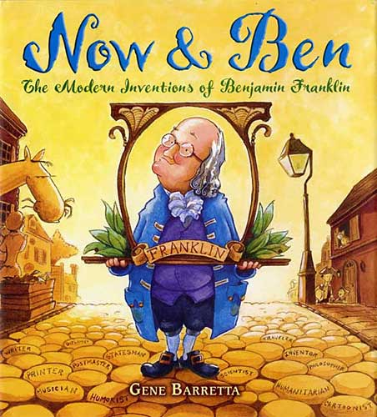
Vocabulary Intro

Slide 2
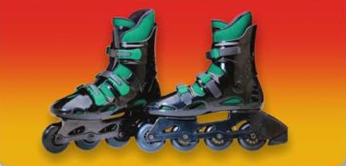
inventions
Inventions are machines or objects that someone has created for the first time.
Wheels are one of the inventions that we use in many different ways.
Do you have any inventions that you thought of?

Slide 3
remarkable
Someone or something that is remarkable is very uncommon or impressive.
The telephone is a remarkable invention that lets you talk to people.
What have you seen or heard about that you think is remarkable?

Slide 4
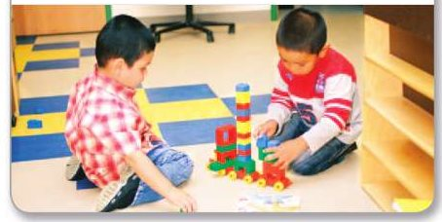
designed
If you designed something, you planned the way it should be made and how it should look.
These boys designed and built a truck from blocks that snap together.
If you designed a new house, how would you make it special?

Slide 5
amounts
If you want to know the amounts of certain items, you need to know the quantities, or how much of the items there are.
These light bulbs give off different amounts of light.
What animals do you think eat the largest amounts of food every day?

Slide 6
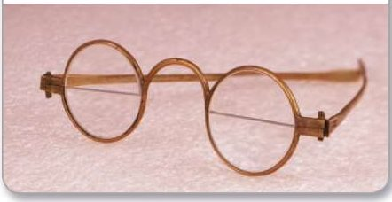
accomplishments
A person’s accomplishements are the things that he or she has achieved or done successfully.
One of Ben Franklin’s many accomplishments was bifocal glasses to see near and far.
Who is someone you admire for his or her accomplishments?

Slide 7
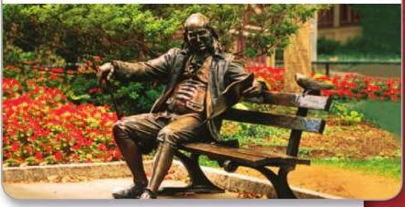
achieve
If you achieve something, you succeed in doing something after a lot of work and effort.
Wanting to succeed helped Ben achieve, or reach, his goals. This is a statue of Ben.
What have you teachers helped you achieve?

Slide 8
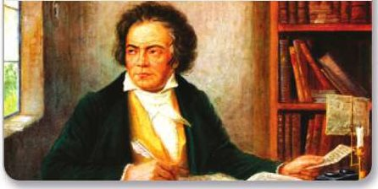
composed
When you have composed music or writing, you have put together notes or words and written them down.
Beethoven is famous for the beautiful music he composed, or wrote.
What have you composed in school?

Slide 9
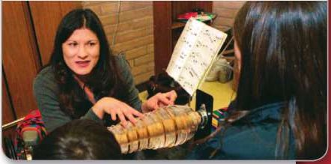
result
A result is something that happens because of something else that has happened.
When a musician plays the armonica, beautiful music is the result!
What might the result be if you helped your family around the house?

